Slide 1

LIFE CYCLE OF
DATA SCIENCE PROJECT
-DIABETES DATASET
-ATITHI SHRESTHA
STUDENT ID : 23140734
SUNWAY COLLEGE, KATHMANDU

Slide 2

MOTIVATION BEHIND THE CHOSEN DOMAIN
-Problem Statement:
What are the factors that causes diabetes?
-Solution:
Analyze the dataset, identify significant patterns, correlations, and risk factors associated with diabetes, providing insights that can inform preventive measures and personalized healthcare strategies.

Slide 3

GOALS OF THE CHOSEN DOMAIN
Public Health Improvement.
Disease Prevention and Management.
Risk Stratification.
Reducing Healthcare Disparities.
Empowering Individuals for Self-Care.

Slide 4
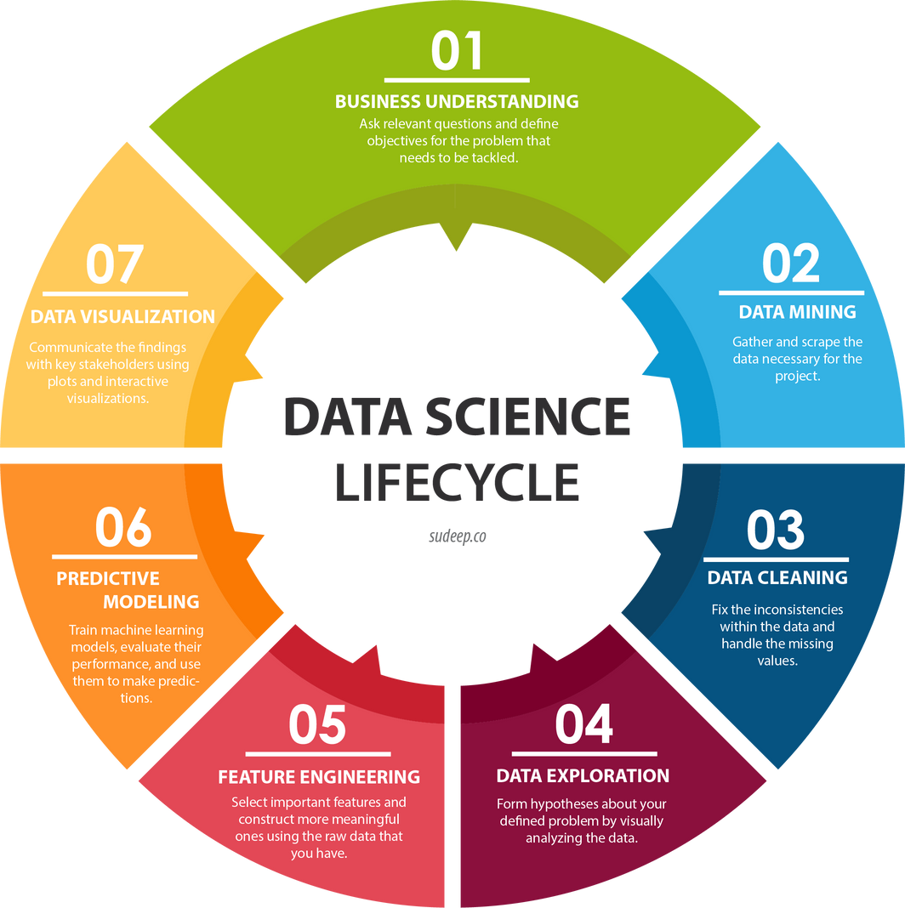
LIFE CYCLE OF DATA SCIENCE
2
3
Data Cleaning and Exploration
Data Analysis and Visualization
1
4
Data Collection
Data Modeling
6
5
Risk Assessment
Feature Engineering

Slide 5
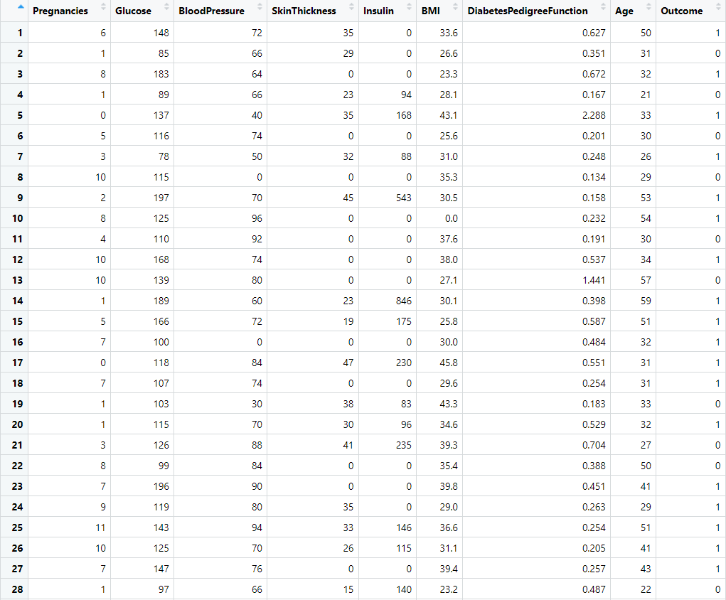
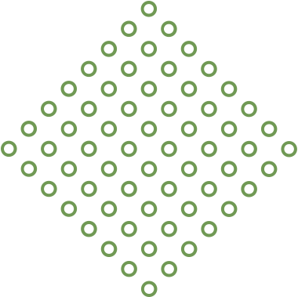
UNDERSTANDING THE MAIN DATASET
What does the features in the column of the dataset represents?
Pregnancies: The number of times the individual has been pregnant.
Glucose: Express glucose level in blood.
BloodPressure: Diastolic Blood Pressure (mmHg)
SkinThickness: Triceps Skin Fold Thickness (mm)
Insulin: Express insulin level in blood.
BMI: Body Mass Index.
DiabetesPedigreeFunction: specific score or measure used to assess the likelihood of a person having diabetes based on their family history..
Age: Age in years.
Outcome: To express the final result. (1 is yes and 0 is no)

Slide 6

NATURE OF DATA COLLECTED
-Tabular
-Structured
-Source: Kaggle
(https://www.kaggle.com/datasets/akshaydattatraykhare/diabetes-dataset )
-Original data from National Institute of Diabetes and Digestive and Kidney.
-All patients are females.
-At least 21 years old of Pima Indian Heritage.
-Excel and CSV
-Numerical data.
-Designed for analysis of factors related to diabetes.

Slide 7
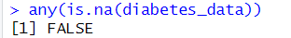
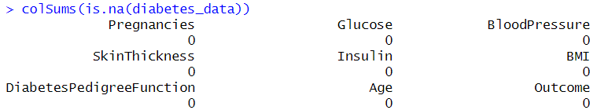
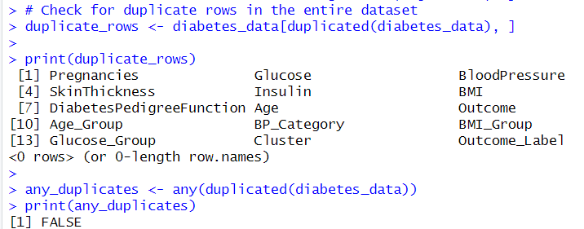
DATA CLEANING

Slide 8
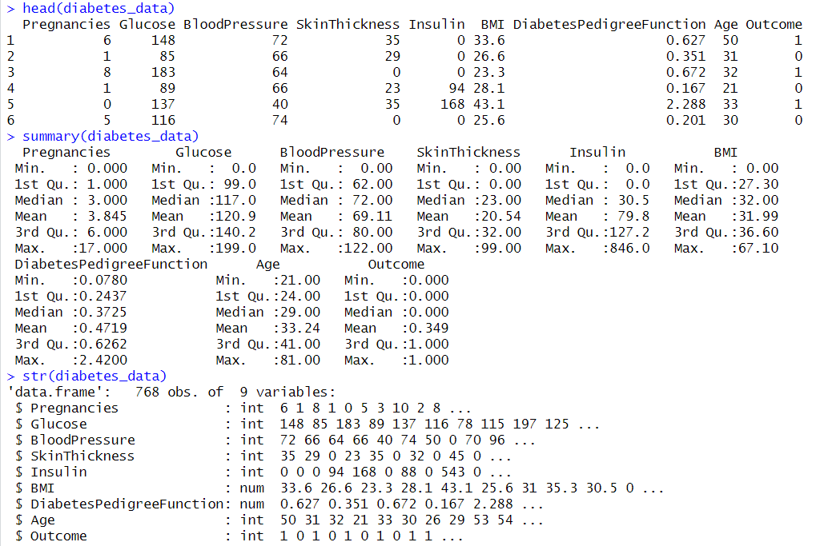
DATA EXPLORATION WITH STRUCTURE

Slide 9
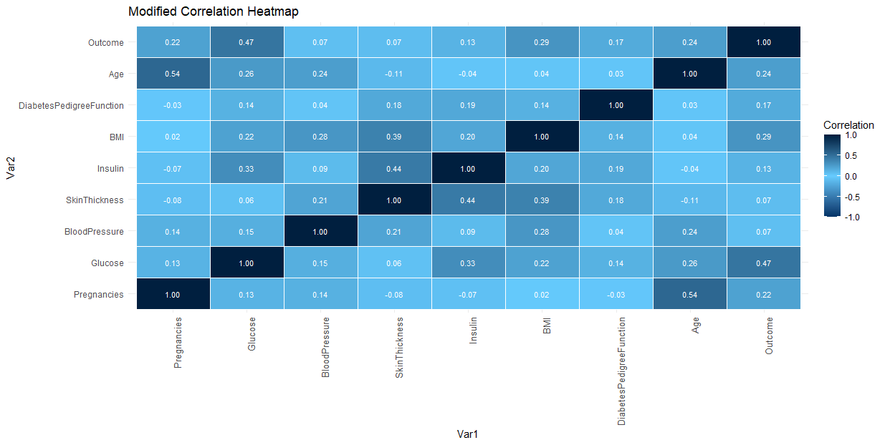

CORRELATION HEATMAP

Slide 10
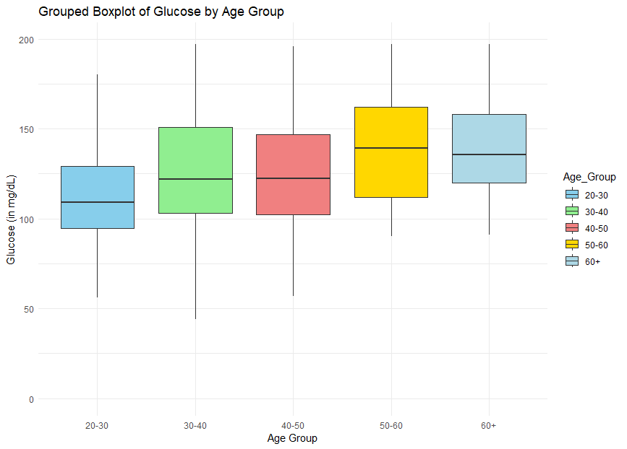
GLUCOSE VS. AGE GROUP.
How can the results of this boxplot be used for decision making in the chosen domain?
IDENTIFICATION OF GLUCOSE VARIABILITY.
CONTINUOUS MONITORING.
TREATMENT CUSTOMIZATION.
RISK STRATIFICATION.
LOW GLUCOSE = glucose < 70mg/dl
NORMAL GLUCOSE = 70-100MG/DL
HIGH GLUCOSE = GLUCOSE > 120

Slide 11
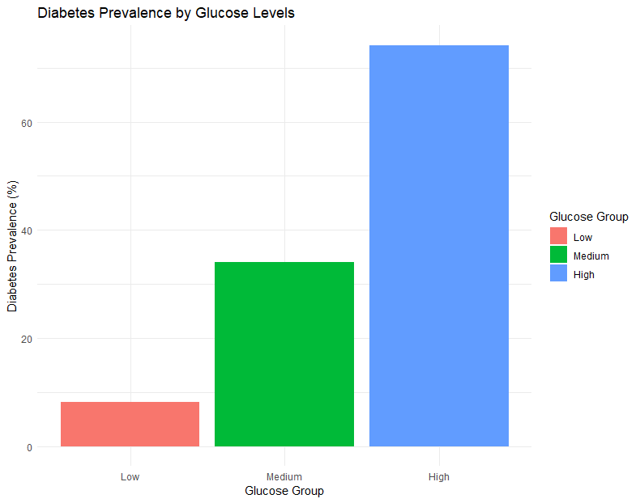
DIABETES PREVALENCE BY GLUCOSE LEVELS
What is diabetes prevalence?
Diabetes prevalence refers to the proportion or percentage of individuals within a population or a specific group who have diabetes.
How is it calculated?
It is typically calculated by dividing the number of individuals with diabetes by the total number of individuals in the population or group and multiplying by 100 to get a percentage.
0% Diabetes Prevalence: No individuals with diabetes in that particular BMI group.
50% Diabetes Prevalence: Half of the individuals in that BMI group have diabetes.
100% Diabetes Prevalence: All individuals in that BMI group have diabetes.
LOW GLUCOSE = glucose < 70mg/dl
NORMAL GLUCOSE = 70-100MG/DL
HIGH GLUCOSE = GLUCOSE > 120

Slide 12
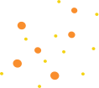
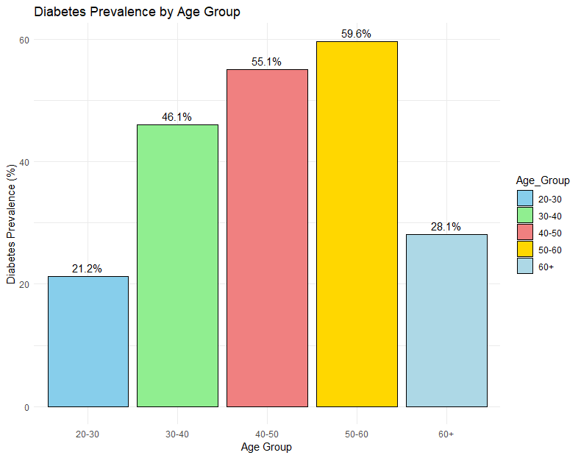
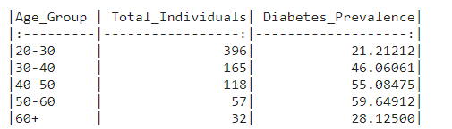

DIABETES PREVALENCE BY AGE GROUP.
How can the results of this bar graph be used for decision making in the chosen domain?
IDENTIFY HIGH-RISK AGE GROUPS.
HEALTHCARE PLANNING.
MONITORING TRENDS.
PATIENT CARE.

Slide 13
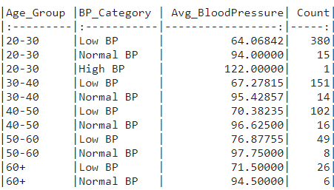
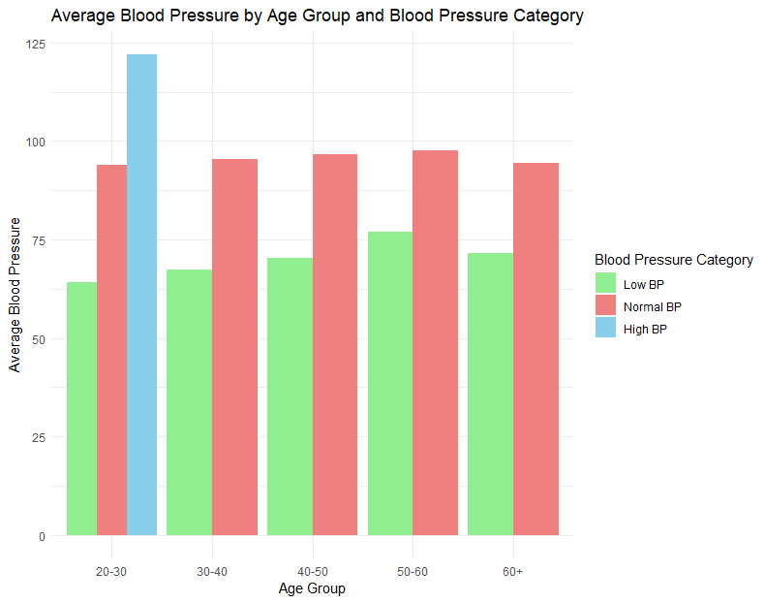
AVERAGE BLOOD PRESSURE VS AGE GROUP
How can the results of this bar plot be used for decision making in the chosen domain?
PATIENT CARE.
PREVENTIVE INTERVENTIONS
PUBLIC HEALTH CAMPAIGNS.
MEDICATION MANAGEMENT

Slide 14
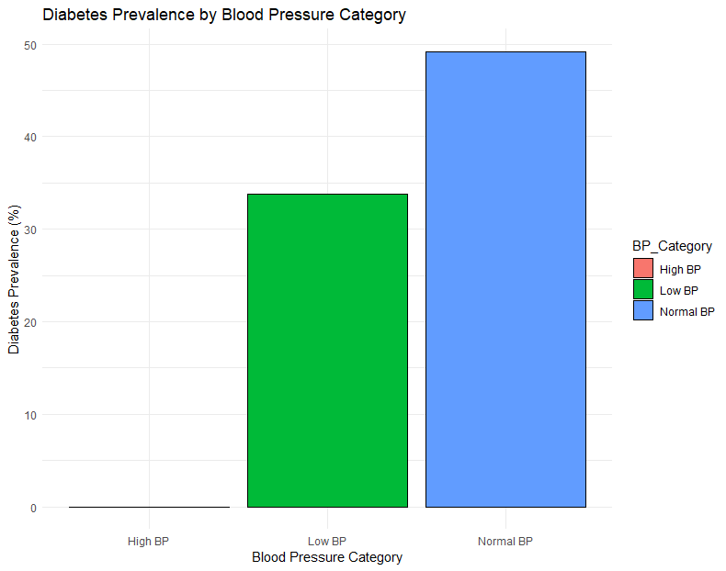
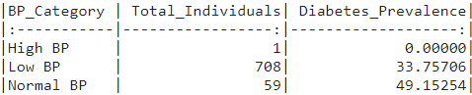
DIABETES PREVALENCE ON THE BASIS OF BLOOD PRESSURE CATEGORY
How can the results of this bar plot be used for decision making in the chosen domain?
CLINICAL GUIDELINESS.
PREVENTIVE STRATEGIES
PUBLIC HEALTH CAMPAIGNS.
PATIENT EDUCATION.
LOW BP = BP < 90
NORMAL BP = 90 - 120
HIGH BP = BP > 120

Slide 15
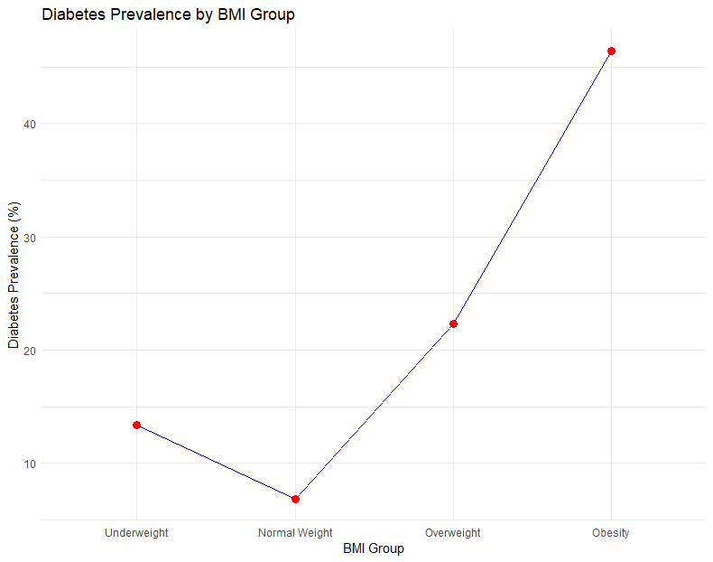
DIABETES PREVALENCE BY DIFFERENT BMI GROUPS.
How can the results of this line graph be used for decision making in the chosen domain?
TREND IDENTIFICATION.
RISK STRATIFICATION.
CLINICAL GUIDANCE.
PUBLIC HEALTH CAMPAIGNS
UNDERWEIGHT = 0 - 18.5
NORMAL = 18.5 -25
OVER WEIGHT = 25 - 30
OBESITY = 30+

Slide 16
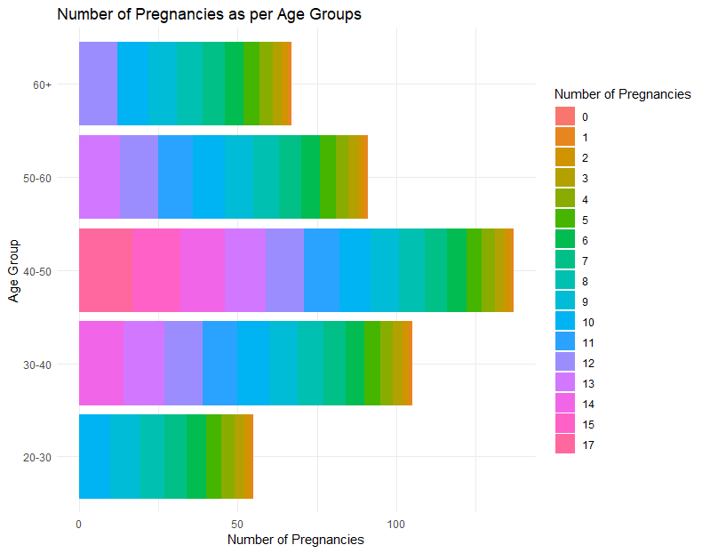
PREGNANCY COUNT AS PER AGE GROUP
For each age group, we can observe how many individuals fall into different categories of pregnancies. in the '20-30' age group, we can see the distribution of individuals with 0 , 1 , 2 pregnancies, and so on. The height of each bar represents the count of individuals in that age group with a specific number of pregnancies. For example, if a bar is taller for '2 pregnancies' in the '30-40' age group, it means there are more individuals in that age group with 2 pregnancies.
PREGNANCY AS PER AGE GROUP
How can the results of this clusters be used for decision making in the chosen domain?
REPRODUCTIVE HEALTH PLANNING
IDENTIFYING TRENDS.
COMMUNITY ENGAGEMENT
RESOURCE ALLOCATION

Slide 17
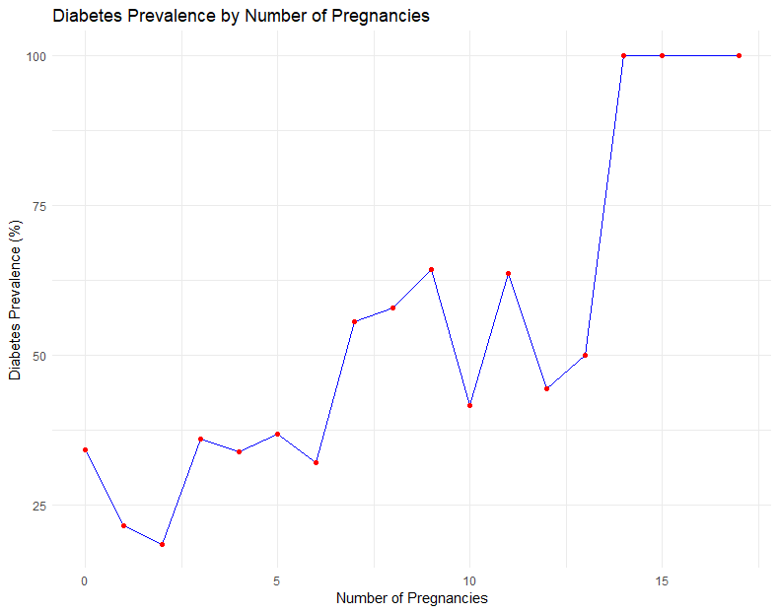
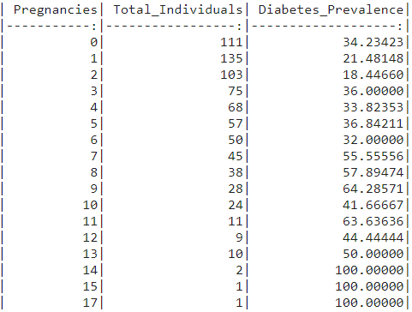
DIABETES PREVALENCE BY NUMBER OF PREGNANCY COUNT.
The plot indicates the percentage of individuals with diabetes for each number of pregnancies, but it doesn't imply causation. It shows the diabetes prevalence within each group of pregnancies. For example, for individuals with 7 pregnancies, 55.6% of them in the dataset have diabetes, but it doesn't mean that having 7 pregnancies causes diabetes. It suggests a correlation or association between the number of pregnancies and diabetes prevalence in the given dataset, but causation cannot be inferred from this information alone.

Slide 18
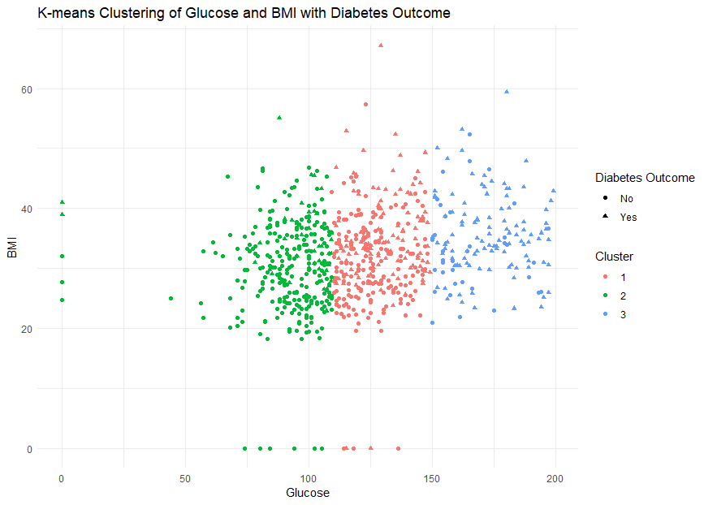
DATA MODELING USING K-MEANS CLUSTERING.
How can the results of this clusters be used for decision making in the chosen domain?
CLUSTER PATTERNS
OUTCOME ANALYSIS
RISK STRATIFICATION.
INDIVIDUALIZED CARE.

Slide 19
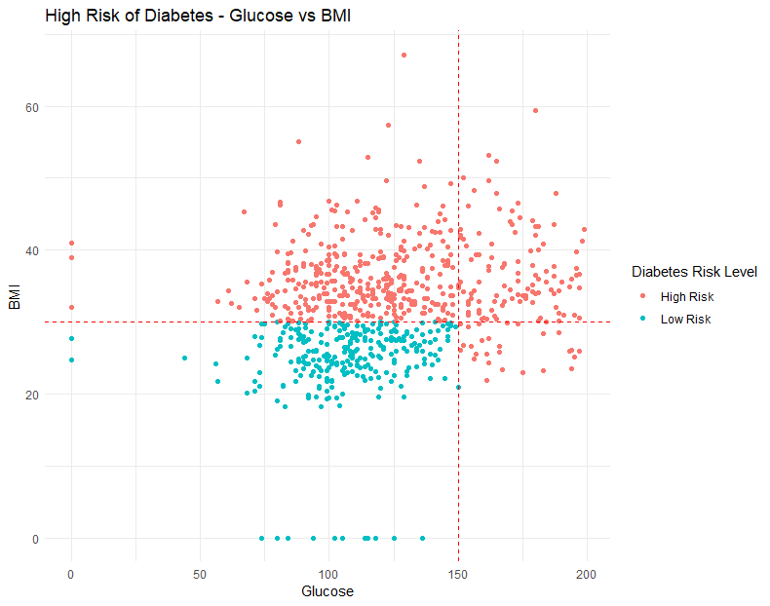
HIGH RISK FACTOR THAT CAUSES DIABETES.
How can the results of this plot be used for decision making in the chosen domain?
RISK VISUALIZATION.
IDENTIFICATION OF HIGH-RISK INDIVIDUALS.
PATIENT COUNSELING.
TELEMEDICINE AND REMOTE MONITORING
The red line is the high-risk threshold in the plot.

Slide 20
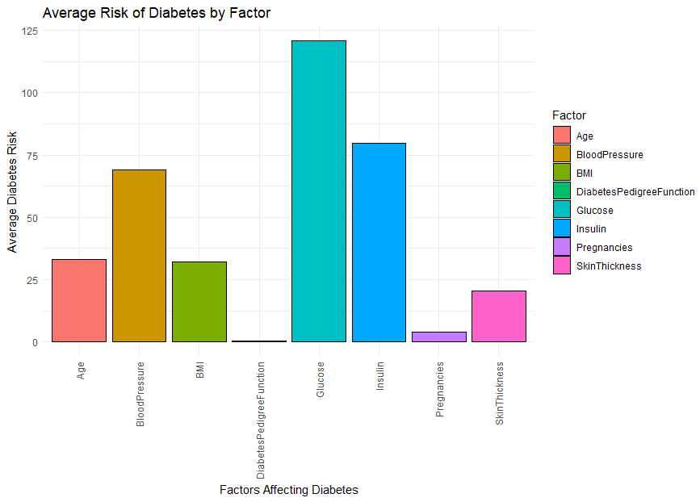
AVERAGE RISK OF DIABETES BY FACTOR
How can the results of this graph be used for decision making in the chosen domain?
FACTOR COMPARISON.
PRIORITIZATION.
RESOURCE ALLOCATION.
RESEARCH FOCUS.

Slide 21

CONCLUSION
-Higher Prevalence of Diabetes in the 50-60 and above age group.
-Correlation between Blood Pressure and Diabetes.
-Glucose and BMI has crucial risk.
-Relationship between Pregnancy and Diabetes Prevalence.
-K-means clustering in Glucose and BMI.
-Introduction of features like BMI categories and High Blood Pressure Indicatiors.
-Preventions and Public Awareness.

Slide 22






DECISION-MAKING
Early Detection and Screening
Patient Stratification
Early Leverage insights from factors influencing diabetes prevalence, such as pregnancies, glucose levels, and BMI, to design early detection and screening programs that can lead to timely interventions and improved outcomes.
The clustering results to stratify patients into different risk groups which can aid healthcare providers in tailoring treatment plans and monitoring strategies based on the identified clusters.
Resource Allocation
Awareness Campaigns
Allocate healthcare resources efficiently by focusing on the identified high-risk factors and age groups. This can optimize resource utilization and ensure that interventions are directed where they are most needed.
Use the findings to develop educational materials and awareness campaigns. These can target specific demographics and provide information on the importance of early detection, lifestyle modifications, and regular health check-ups.
Targeted Interventions
Telehealth Initiatives
Identify high-risk groups based on age, blood pressure, glucose levels, and other factors. Implement targeted interventions and awareness campaigns for these specific groups to promote healthier lifestyles and preventive measures.
Explore the potential for telehealth initiatives, especially for remote monitoring and support for individuals in high-risk categories. Telehealth can enhance accessibility to healthcare services and facilitate continuous monitoring.

Slide 23
REFERENCES
Kaggle: Kaggle. (n.d.). Diabetes Dataset. Available at: https://www.kaggle.com/datasets/akshaydattatraykhare/diabetes-dataset/data.
Article : - Smith, J.W., Everhart, J.E., Dickson, W.C., Knowler, W.C. and Johannes, R.S. (1988). "Using the ADAP Learning Algorithm to Forecast the Onset of Diabetes Mellitus." Proceedings of the Annual Symposium on Computer Application in Medical Care, pp.261–265. Available at: https://www.ncbi.nlm.nih.gov/pmc/articles/PMC2245318/
A review of diabetes datasets - researchgate. Available at: A review of diabetes datasets - researchgate. Available at: https://www.researchgate.net/profile/Ahmed-Garko/publication/364433378_A_Review_of_Diabetes_Datasets/links/64083e32b1704f343fb2431e/A-Review-of-Diabetes-Datasets.pdf.
Dr. Manpreet Singh, Dr. Pankaj Bhambri, Dr. Inderjit Singh, Dr. Amit Jain, Er. Kirandeep Kaur (2021) “Data Mining Classifier for Predicting Diabetics”, Annals of the Romanian Society for Cell Biology, pp. 6702 –. Available at: Dr. Manpreet Singh, Dr. Pankaj Bhambri, Dr. Inderjit Singh, Dr. Amit Jain, Er. Kirandeep Kaur (2021) “Data Mining Classifier for Predicting Diabetics”, Annals of the Romanian Society for Cell Biology, pp. 6702 –. Available at: https://www.annalsofrscb.ro/index.php/journal/article/view/3266.
Images: Free images: Photos, vectors, Clipart, icons, PSD & More! Freeimages. Available at: https://www.freeimages.com/
Shutterstock, 2024, Awareness Campaign Images, Available at: https://www.shutterstock.com/search/awareness-campaign
FM Magazine, 2019, Resource Allocation Best Practices, FM Magazine, Available at: https://www.fm-magazine.com/news/2019/nov/resource-allocation-best-practices-201922378.html.
Unsplash (no date) Beautiful free images & pictures, Unsplash. Available at: https://unsplash.com/.

Slide 24

ANY QUESTIONS
???

Slide 25

THANK YOU
FOR YOUR ATTENTION!!!

